Slide 1

MACHINE LEARNING

Slide 2

machine learning
A branch of artificial intelligence (AI) technology that uses the structured/unstructured raw data and mathematical algorithms powered by the software programs, which enable the machines to imitate the ways humans learn from the real-world environment and improve accuracy with the increased experience with the real-world data without being explicitly programmed through computer instructions to do so.

Slide 3

Importance of Machine Learning in Modern World
e-Commerce
Customer support
Online trading
Language services
Entertainment and media—
Marketing and Business Intelligence (BI)—

Slide 4
machine learning activity of function
Descriptive Function
Perceptive function
Predictive function
This function of machine learning system uses the data to learn and explain what has happened in the given situation through a descriptive capability.
This capability of machine learning enables the users to get suggestions through the analysis of the data from the machine learning systems about what action is to take in the given situation of the data.
This feature enables the intelligent systems to project about the future situation. What will happen under the given conditions based on the raw data?

Slide 5
machine learning activity of function
Decision process
Error function process
Model optimization process
In this phase, the data is fed to the ML systems in the form of training datasets—either in labeled or unlabeled forms.
In the second phase of the machine learning low, the ML systems will assess the error in the function or outcome if the previous data exists.
This is the last phase of machine learning that continues as the database or knowledgebase of the system increases.

Slide 6

Types of Machine Learning
1
Supervised Machine Learning
2
Unsupervised Machine Learning
3
Semi-Supervised Machine Learning
4
Reinforcement Machine Learning

Slide 7

Supervised Machine Learning
Supervised machine learning, also referred as supervised learning, is a type of machine learning in which the training datasets are created by labeling and annotation to feed to the algorithm for developing understanding of the data by major functions such as classification and prediction.

Slide 8

Unsupervised Machine Learning
In this type of machine learning, the unlabeled or untagged datasets are used for training the machine learning algorithms to conduct cluster analysis on those datasets.

Slide 9

Semi-supervised Machine Learning
In this kind of machine learning, a small volume of labeled data is used to train the ML-model irst and then a huge volume of untagged or labeled data are used for training the machine learning models.

Slide 10

Reinforcement Machine Learning
In this method, training to the ML-model is done through feedback of the step taken by the AI-agent in the AI-environment.

Slide 11
DEEP MACHINE LEARNING
Deep machine learning, precisely known as DL, is a type of machine learning, which is powered by the use of neural networks to learn about the problem without any human intervention

Slide 12
artificial neural network
An artificial neural network, precisely referred to as ANN, is a structure of multiple layers for processing the data to develop a deeper understanding of the problem without any human intervention.

Slide 13
Major Methods/Techniques of Machine Learning
Regression Model
Decision Trees
Classification
Clustering
Anomaly Detection
Neural Network Method
Dimensionality Reduction
Ensemble Methods
Transfer Learning

Slide 14
Natural Language Processing (NLP)
This is the computational process, which enables the machines to understand, read, and derive meaning from the data input in natural language in the form of text or speech that humans communicate with.

Slide 15
WORD EMBEDDING
Word embedding is a commonplace word in natural language processing. This is a type of presentation of a word that resembles to the characteristics of the representation of the words of the same meaning.

Slide 16
machine learning algorithm
ML Algorithm is a set of rules based on certain mathematical and logical calculations to solve a problem through intelligent machines like neural networks, AI programs, and other intelligent systems.

Slide 17
Classification Algorithms: Naïve Bayes
Naıv̈e Bayes algorithm is based on the rule of probability proposed by Naıv̈e Bayes.

Slide 18
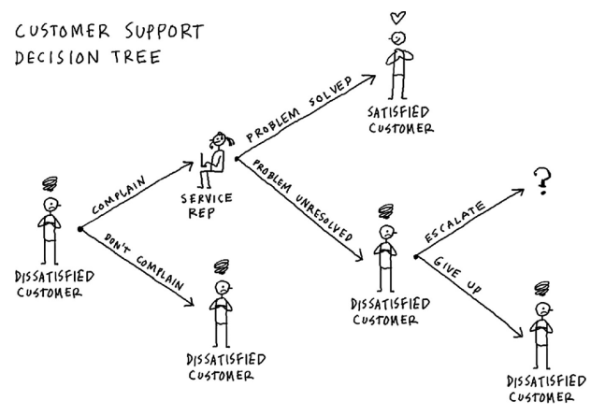
Classification Algorithms: Decision Tree
Decision tree is a step-by-step logical tree starting from the stem passing through the branches and each external node is incorporated as a test.

Slide 19
Classification Algorithms: Random Forest
Random Forest is a type of algorithm that consists of multiple decision trees acting as subset of an algorithm acting under the given (certain) conditions

Slide 20
Classification Algorithms: K Nearest Neighbor
K Nearest Neighbor algorithm is another very important one in the field of artificial intelligence, especially machine learning domain. It is used for both classification and regression related solutions.

Slide 21
Clustering Algorithms
Clustering algorithms are the mathematical techniques used to group the data points into different natural clusters or groups.

Slide 22
Expectation Maximization (EM) Algorithm
This algorithm is designed to maximize the expected attributes or characteristics of a cluster of data points. T

Slide 23
Agglomerative Hierarchical Clustering
In this algorithm, all the data points are initially considered as a separate cluster and then merged into each other on the basis of their attributes and characteristics.

Slide 24
Fuzzy C-Means Algorithm
In this algorithm, the membership coefficient is determined for a data point, which is member of multiple groups or clusters.

Slide 25
Regression algorithms
Regression algorithms are those that estimate or predict the dependent variable(s), which is also referred to as target variable or output, in relationship with many independent variables that can impact the value of the target variable.

Slide 26
linear regression
The linear regression predicts the trend of target value in a straight line drawn with respect to the impact of an independent variable (data point). This type of algorithm generates the most it line to depict the target value under the given range of independent variables.

Slide 27
multilinear regression
In multilinear regression, one target value is determined by following the same technique as used in the simple linear regression with more than one predictor variables or independent variables.

Slide 28
Multivariate regression
Multivariate regression is another type of algorithm used to predict multiple outcomes or target variables in terms of multiple predictors. This model is more effective in the situations when multiple independent variables are influenced by the dependent variable(s)

Slide 29
Logistic regression
Logistic regression is another very important type of regression-based algorithms. It is extensively used in statistical analysis for determining logical outcomes in the form of two states.

Slide 30
Lasso Regression
The Least Absolute Selection Shrinkage Operator, precisely referred to as LASSO, is a type of regression-based algorithm, which puts the constraint or shrinkage on the attributes or parameters to reduce them to zero or near zero.

Slide 31
Other Regression algorithms
Poison regression algorithm
Ridge regression algorithm
Polynomial regression algorithm
Bayesian linear regression algorithm
Quantile regression algorithm
Elastic net regression algorithm
Principal component regression

Slide 32
ai training data
Any kind of data in the form of text, audio, video, image, or senses like thrust, temperature, light, touch, smell, and others that can be used for training the artificial intelligence models integrated with the machines so that those machine-powered prediction models can learn, understand, and decide about the future actions is called the training data

Slide 33
Types of Training Data
1
Text
2
Audio
3
Video
4
Image
5
Sensory

Slide 34
ai training data set
Data types that are labeled, classified, tagged, and annotated in different formats, attributes, tools, and classes in such a way that the machine learning algorithms can easily understand them and keep in their artiicial mind (database) for making future decisions regarding the similar kinds of situations or conditions in the real-world problems.

Slide 35
process for building training data sets
1
Data Collection
2
Data Cleaning
3
Data Classification
4
Data Categorization
5
Data Annotation and Labeling

Slide 36
Image Data Annotation
Identifying, labeling, and categorizing the image and its items is called image data annotation process

Slide 37
Image Data Annotation
1
Bounding Box Annotation
2
3D Cuboids Annotation
3
Polygon Annotation
4
Lines and Splines
5
Semantic Segmentation

Slide 38
text data annotation
Identifying and assigning the labels to the text in a digital file is called as text data annotation. It is used for supervised machine learning in artificial intelligence

Slide 39
Text Data Annotation
1
Entity Annotation
2
Entity Linking
3
Sentiment Annotation
4
Text Classiication

Slide 40
Audio Data Annotation
Audio data annotation is a process of labeling different types of audios with predefined attributes such as names, quality, noises, sound types, frequencies, emotions, and others.

Slide 41
Audio Data Annotation
1
Sound Labeling
2
Event Tracking
3
Speech to Text Transcription
4
Audio Classification
5
Multi-labeling

Slide 42
Video Data Annotation
Video annotation is a process in which the video clips are tagged or labeled frame-by-frame to generate a training dataset for machine learning and deep learning projects.

Slide 43
Video Data Annotation
1
Key Points Annotation/Landmarks
2
Object Localization
3
Object Tracking
4
Gradient Boosting

Slide 44
uses of machine language
Big Data
Data Analytics
Cybersecurity
Digital Marketing
Business Intelligence
Process Automation
Automobiles
e-Commerce

Slide 45
Impact of Machine Learning on Cybersecurity
Positive Impact
Negative Impact

Slide 46

THANK YOU FOR LISTENING!

